Slide 1
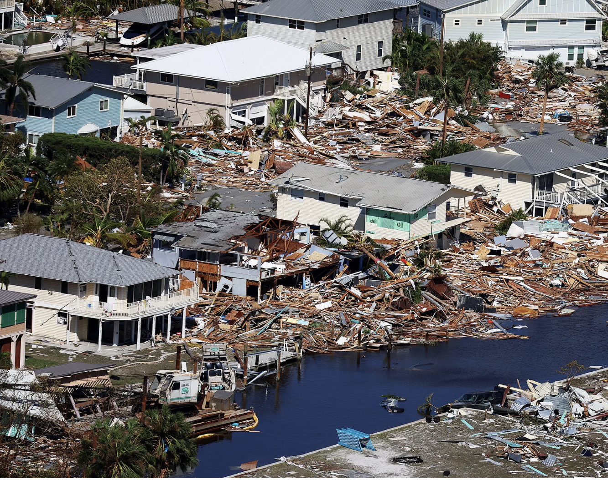
Hurricanes & AI

Slide 2
Hurricane Ian
Hurricane Ian hit Florida in late Sep. 2022.
Recorded as the third-costliest weather disaster in the world.
Damage reached South and North Carolina.

Slide 3
How can AI help in Hurricanes?
Around 3,500 residents of Collier, Charlotte, and Lee counties recevied notifications on their smartphones offering $700 cash assistance.
How this cash assistance reach those people without any questions asked or surveys?

Slide 4
The charm of AI
GiveDirectly tested this new way of targting emergency aid in collaboration with Google.org.
Targeted the most in need individuals using the help of a benfits app called Providers.

Slide 5
GiveDirectly and AI
Used this technology for the first time in the US.
Previously tested similar idea in Togo at the time of the pandemic.

Slide 6
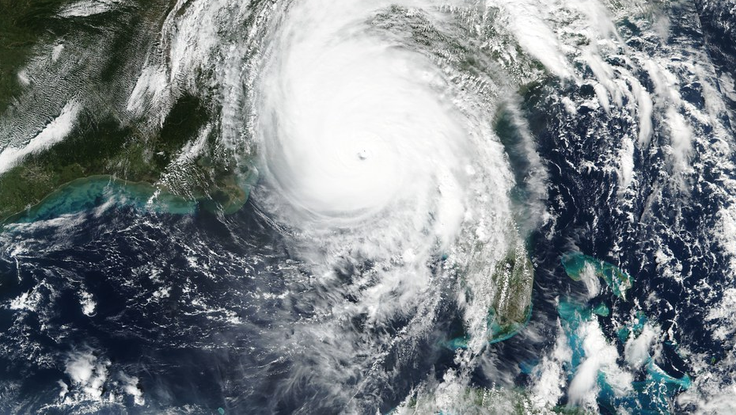
More details on Florida project

Slide 7
Powered by Mapping tool ‘Delphi’
Live maps of storm damage
Provided by Google tool called ‘Skai’
Data on poverty

Slide 8
GiveDirectly succeeded to push notificatins to all users of Providers app with a registered address in neighborhoods of the three counties.
900 people have taken up the offer
if every recipient takes up GiveDirectly’s offer. The organization will pay out $2.4 million in direct financial aid,.

Slide 9
Advantages
Before their project with Google, GiveDirectly work after Hurricane Harvey, two out of three areas that were most damaged were initially overlooked.
System appears to offer a more efficient way of delivering aid.
It protects the dignity of recipients.

Slide 10
Drawbacks
Automating the system to such a large extent, there’s a risk of losing people who might need help the most.
An unexpected message offering cash can be suspecting for some people.
Not all devastated locations were picked up by the algorithms.

Slide 11
Thank you

